Slide 1
Chapter 12
How to create and use classes

Slide 2
Objectives (part 1)
Applied
Given the specifications for an application that uses classes with any of the members presented in this chapter, develop the application and its classes.
Use the Solution Explorer to browse the classes in a solution.
Use the Peek Definition window to display and edit the code for a member in another class from within the class that refers to it.
Knowledge
List and describe the three layers of a three-layered application.
Describe these members of a class: constructor, method, field, and property.
Describe the concept of encapsulation.
Explain how instantiation works.

Slide 3
Objectives (part 2)
Describe the main advantage of using object initializers.
Describe the concept of overloading a method.
Explain what a static member is.
Explain how auto-implemented properties work.
Explain how expression-bodied properties, accessors, methods, and constructors work.
Describe pattern matching, including property patterns.
Describe the basic procedure for using the live code analysis feature to generate code stubs.
Describe the difference between a class, a structure, and a record.

Slide 4
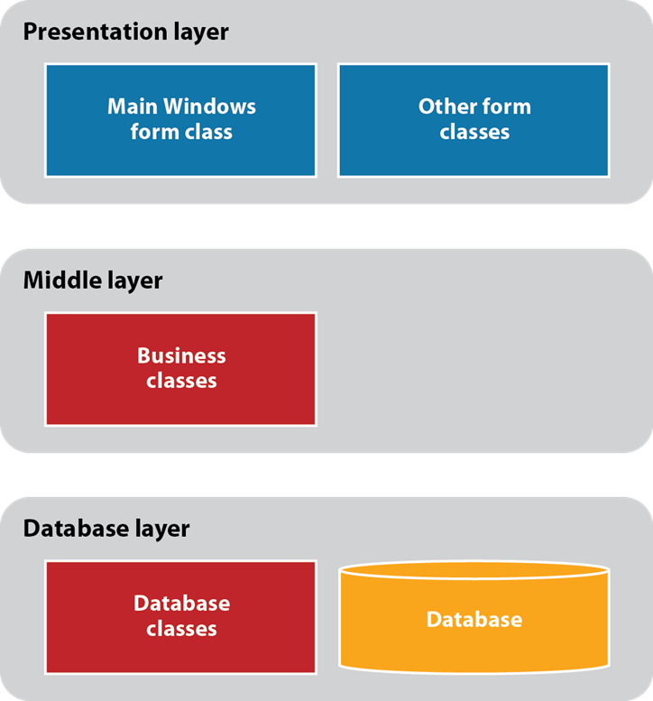
The architecture of a three-layered application

Slide 5
The members of a Product class (part 1)
Properties Description
Code A string that contains a code that uniquely identifies each product.
Description A string that contains a description of the product.
Price A decimal that contains the product’s price.
Method Description
GetDisplayText(sep) Returns a string that contains the code, description, and price in a displayable format. The sep parameter is a string that’s used to separate the elements. It’s typically set to a tab or new line character.

Slide 6
The members of a Product class (part 2)
Constructors Description
() Creates a Product object with default values.
(code, description, price) Creates a Product object using the specified code, description, and price values.

Slide 7
Types of class members (part 1)
Member Description
Property Represents a data value associated with an object instance.
Method An operation that can be performed by an object.
Constructor A special type of method that’s executed when an object is instantiated.
Delegate A special type of object that’s used to pass a method as an argument to other methods.
Event A signal that notifies other objects that something noteworthy has occurred.
Field A variable that’s declared at the class level.
Constant A constant.

Slide 8
Types of class members (part 2)
Indexer A special type of property that allows individual items within the class to be accessed by index values. Used for classes that represent collections of objects.
Operator A special type of method that’s performed for a C# operator such as + or ==.
Class A class that’s defined within the class.

Slide 9
Class and object concepts
An object is a self-contained unit that has properties, methods, and other members. A class contains the code that defines the members of an object.
An object is an instance of a class, and the process of creating an object is called instantiation.
Encapsulation is one of the fundamental concepts of object-oriented programming. It lets you control the data and operations within a class that are exposed to other classes.
The data of a class is typically encapsulated within a class using data hiding. In addition, the code that performs operations within the class is encapsulated so it can be changed without changing the way other classes use it.
Although a class can have many different types of members, most of the classes you create will have just properties, methods, and constructors.

Slide 10
The Product class: Fields and constructors
namespace ProductMaintenance
{
public class Product
{
private string code;
private string description;
private decimal price;
public Product(){}
public Product(string code, string description,
decimal price)
{
this.Code = code;
this.Description = description;
this.Price = price;
}

Slide 11
The Product class: The Code property
public string Code
{
get
{
return code;
}
set
{
code = value;
}
}

Slide 12
The Product class: The Description property
public string Description
{
get
{
return description;
}
set
{
description = value;
}
}

Slide 13
The Product class: The Price property
public decimal Price
{
get
{
return price;
}
set
{
price = value;
}
}

Slide 14
The Product class: The GetDisplayText method
public string GetDisplayText(string sep)
{
return code + sep + price.ToString("c") + sep +
description;
}
}
}

Slide 15
Two Product objects that have been instantiated from the Product class
product1
Code=C#
Description=Murach’s C#
Price=59.50
product2
Code=ASPMVC
Description=Murach’s ASP.NET MVC
Price=61.50
Code that declares and creates these two object instances
Product product1, product2;
product1 = new Product("C#", "Murach's C#", 59.50m);
product2 = new Product("ASPMVC", "Murach's ASP.NET MVC",
61.50m);

Slide 16
Code that creates an object and initializes it manually
product1 = new Product();
product1.Code = "C#";
product1.Description = "Murach's C#";
product1.Price = 59.50m;
Code that creates an object with an object initializer
product1 = new Product {
Code = "C#",
Description = "Murach's C#",
Price = 59.50m
};

Slide 17
Three ways to declare and create an object in a single statement
Product product3 = new Product(); // explicitly typed
var product4 = new Product(); // implicitly typed
Product product5 = new(); // C# 9.0 and later

Slide 18
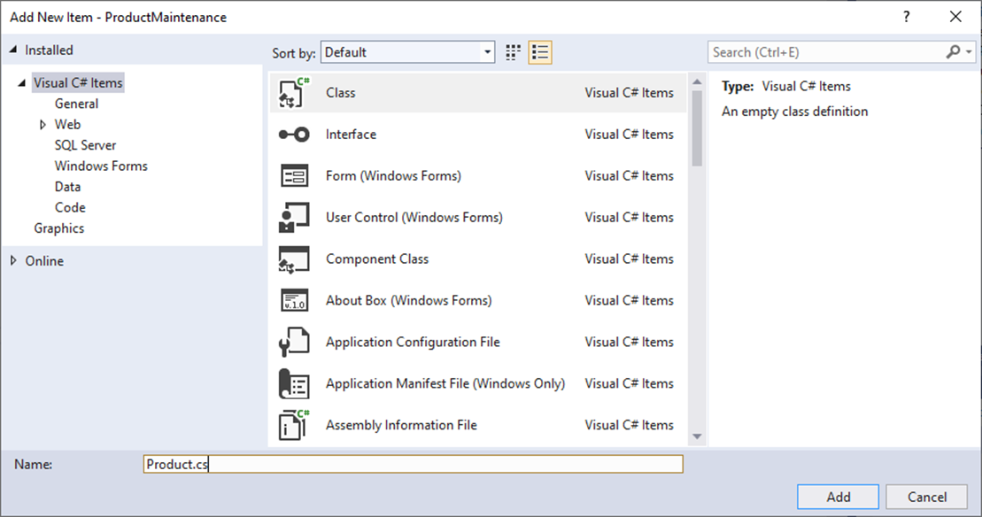
The dialog box for adding a class

Slide 19
The starting code for the new class
using System;
using System.Collections.Generic;
using System.Text;
namespace ProductMaintenance
{
class Product
{
}
}

Slide 20
Examples of field declarations
private int quantity; // A private field
public decimal Price; // A public field
public readonly int Limit = 90; // A public read-only
// field

Slide 21
A Product class that uses public fields
public class Product
{
// Public fields
public string Code;
public string Description;
public decimal Price;
public Product()
{
}
public Product(string code, string description, decimal price)
{
this.Code = code;
this.Description = description;
this.Price = price;
}
public string GetDisplayText(string sep)
{
return Code + sep + Price.ToString("c") + sep + Description;
}
}

Slide 22
The syntax for coding a public property
public type PropertyName
{
[get { get accessor code }]
[set { set accessor code }]
}
A read/write property
public string Code
{
get { return code; }
set { code = value; }
}
A read-only property
public decimal DiscountAmount
{
get
{
discountAmount = subtotal * discountPercent;
return discountAmount;
}
}

Slide 23
A statement that sets a property value
product.Code = txtProductCode.Text;
A statement that gets a property value
string code = product.Code;

Slide 24
The syntax for coding a public method
public returnType MethodName([parameterList])
{
statements }
A method that accepts parameters
public string GetDisplayText(string sep)
{
return code + sep + price.ToString("c") + sep +
description;
}
An overloaded version of the method
public string GetDisplayText()
{
return GetDisplayText(", ");
}

Slide 25
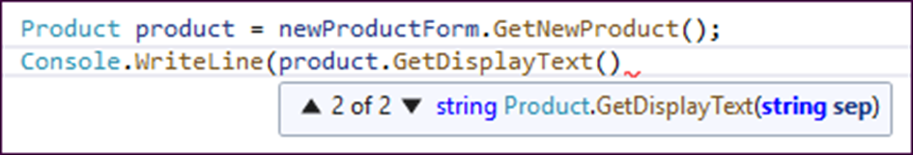
Statements that call the GetDisplayText() method
lblProduct.Text = product.GetDisplayText("\t");
lblProduct.Text = product.GetDisplayText();
How the IntelliSense feature lists overloaded methods

Slide 26
A constructor with no parameters
public Product()
{
}
A constructor with three parameters
public Product(string code, string description,
decimal price)
{
this.Code = code;
this.Description = description;
this.Price = price;
}

Slide 27
A constructor with one parameter
public Product(string code)
{
Product p = ProductDB.GetProduct(code);
this.Code = p.Code;
this.Description = p.Description;
this.Price = p.Price;
}
Statements that call these constructors
Product product1 = new Product();
Product product2 = new Product("C#", "Murach's C#",
59.50m);
Product product3 = new Product(txtCode.Text);

Slide 28
Default values for instance variables
Data type Default value
All numeric types 0
Boolean false
Char null
Object null
Date 12:00 a.m. on January 1, 0001

Slide 29
A class that contains static members
public static class Validator
{
private static string lineEnd = "\n";
public static string LineEnd
{
get { return lineEnd; }
set { lineEnd = value; }
}
public static string IsPresent(string value, string name)
{
string msg = "";
if (value == "")
{
msg += name + " is a required field." + LineEnd;
}
return msg;
}
}

Slide 30
Code that uses static members
string errorMessage = "";
errorMessage += Validator.IsPresent(
txtCode.Text, txtCode.Tag.ToString());
errorMessage += Validator.IsPresent(
txtDescription.Text, txtDescription.Tag.ToString());
if (errorMessage != "")
MessageBox.Show(errorMessage, "Entry Error");

Slide 31
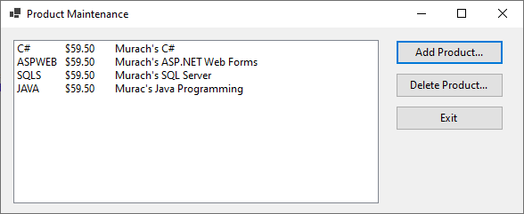
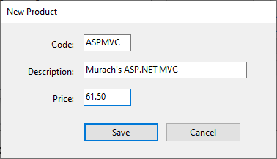
The Product Maintenance form
The New Product form

Slide 32
The Tag property settings for the text boxes on the New Product form
Control Tag property setting
txtCode Code
txtDescription Description
txtPrice Price

Slide 33
The Product class (part 1)
Property Description
Code A string that contains a code that uniquely identifies the product.
Description A string that contains a description of the product.
Price A decimal that contains the product’s price.
Method Description
GetDisplayText(sep) Returns a string that contains the code, description, and price separated by the sep string.

Slide 34
The Product class (part 2)
Constructor Description
() Creates a Product object with default values.
(code, description, price) Creates a Product object using the specified values.

Slide 35
The ProductDB class
Method Description
GetProducts() A static method that returns a List<> of Product objects from the Products file.
SaveProducts(list) A static method that writes the products in the specified List<> of Product objects to the Products file.

Slide 36
The Validator class
Property Description
LineEnd A static string that contains the delimiter that’s added to the end of an error message. The default is “\n”.
Static method Returns an error message…
IsPresent(value, name) If the value that’s passed to it is an empty string.
IsInt32(value, name) If the value that’s passed to it isn’t an integer.
IsDecimal(value, name) If the value that’s passed to it isn’t a decimal.
IsWithinRange(value, If the value that’s passed to it isn’t name, min, max) within the specified range.

Slide 37
Code for the Product Maintenance form (part 1)
public partial class frmProductMain : Form
{
public frmProductMain()
{
InitializeComponent();
}
private List<Product> products = null;
private void frmProductMain_Load(object sender, EventArgs e)
{
products = ProductDB.GetProducts();
FillProductListBox();
}
private void FillProductListBox()
{
lstProducts.Items.Clear();
foreach (Product p in products) {
lstProducts.Items.Add(p.GetDisplayText("\t"));
}
}

Slide 38
Code for the Product Maintenance form (part 2)
private void btnAdd_Click(object sender, EventArgs e)
{
frmNewProduct newProductForm = new frmNewProduct();
Product product = newProductForm.GetNewProduct();
if (product != null)
{
products.Add(product);
ProductDB.SaveProducts(products);
FillProductListBox();
}
}
private void btnDelete_Click(object sender, EventArgs e)
{
int i = lstProducts.SelectedIndex;
if (i != -1)
{
Product product = products[i];
string message = "Are you sure you want to delete " +
product.Description + "?";

Slide 39
Code for the Product Maintenance form (part 3)
DialogResult button =
MessageBox.Show(message, "Confirm Delete",
MessageBoxButtons.YesNo);
if (button == DialogResult.Yes)
{
products.Remove(product);
ProductDB.SaveProducts(products);
FillProductListBox();
}
}
}
private void btnExit_Click(object sender, EventArgs e)
{
this.Close();
}
}

Slide 40
The code for the New Product form (part 1)
public partial class frmNewProduct : Form
{
public frmNewProduct()
{
InitializeComponent();
}
private Product product = null;
public Product GetNewProduct()
{
this.ShowDialog();
return product;
}
private void btnSave_Click(object sender, EventArgs e)
{
if (IsValidData())
{
product = new Product(txtCode.Text, txtDescription.Text,
Convert.ToDecimal(txtPrice.Text));
this.Close();
}
}

Slide 41
The code for the New Product form (part 2)
private bool IsValidData()
{
bool success = true;
string errorMessage = "";
errorMessage += Validator.IsPresent(
txtCode.Text, txtCode.Tag.ToString());
errorMessage += Validator.IsPresent(
txtDescription.Text, txtDescription.Tag.ToString());
errorMessage += Validator.IsDecimal(
txtPrice.Text, txtPrice.Tag.ToString());
if (errorMessage != "") {
success = false;
MessageBox.Show(errorMessage, "Entry Error");
}
return success;
}
private void btnCancel_Click(object sender, EventArgs e)
{
this.Close();
}
}

Slide 42
The code for the Validator class (part 1)
public static class Validator
{
private static string lineEnd = "\n";
public static string LineEnd
{
get
{
return lineEnd;
}
set
{
lineEnd = value;
}
}

Slide 43
The code for the Validator class (part 2)
public static string IsPresent(string value, string name)
{
string msg = "";
if (value == "")
{
msg += name + " is a required field." + LineEnd;
}
return msg;
}
public static string IsDecimal(string value, string name)
{
string msg = "";
if (!Decimal.TryParse(value, out _))
{
msg += name + " must be a valid decimal value." +
LineEnd;
}
return msg;
}
}

Slide 44
The syntax for coding an auto-implemented property
public type PropertyName { get; [set;] } [= value]
An auto-implemented property with both get and set accessors
public string Code { get; set; }
An auto-implemented property with a get accessor and an initial value
public string Code { get; } = "C#";

Slide 45
A statement that sets the value of an auto-implemented property
product.Code = txtProductCode.Text;
A statement that gets the value of an auto-implemented property
string code = product.Code;

Slide 46
An auto-implemented property with an init-only setter (C# 9.0 and later)
public string Code { get; init; };
A statement that uses an object-initializer to set the init-only property
var product2 = new Product { Code = "C#" };

Slide 47
A read-only property
public decimal DiscountAmount
{
get
{
return subtotal * discountPercent;
}
}
The same property using an expression body
public decimal DiscountAmount => subtotal * discountPercent;

Slide 48
A read/write property for a private instance variable
public string Code
{
get
{
return code;
}
set
{
code = value;
}
}
The same property using expression-bodied get and set accessors
public string Code
{
get => code;
set => code = value;
}

Slide 49
A method that returns the value of an expression
public string GetDisplayText(string sep) {
return code + sep + price.ToString("c") + sep + description;
}
The same method using an expression body
public string GetDisplayText(string sep) =>
code + sep + price.ToString("c") + sep + description;

Slide 50
A method that executes a single statement
public void DisplayProduct() {
MessageBox.Show("Code: " + code + "\n" +
"Price: " + price.ToString("c") + "\n"
"Description: " + description, "Product");
}
The same method using an expression body
public void DisplayProduct() =>
MessageBox.Show("Code: " + code + "\n" +
"Price: " + price.ToString("c") + "\n" +
"Description: " + description, "Product");

Slide 51
A constructor that has one parameter
public Product(string code) {
this.Code = code; // set other properties
// to default values
}
The same constructor using an expression body
public Product(string code) => this.Code = code;

Slide 52
A constructor with three parameters
public Product(string code, string description, decimal price) {
this.Code = code;
this.Description = description;
this.Price = price;
}
The same constructor using an expression body with a tuple
public Product(string code, string description, decimal price) =>
(this.Code, this.Description, this.Price) =
(code, description, price);

Slide 53
A method that tests an object’s type and property (C# 6.0 and earlier)
public static decimal GetDiscountPercent(Object o) {
decimal discountPercent = .0m;
if (o.GetType() == typeof(Product)) {
Product p = (Product) o;
if (p.Category == ".NET")
discountPercent = .1m;
else if (p.Category == "Java")
discountPercent = .2m;
}
return discountPercent;
}

Slide 54
Methods that use pattern matching (C# 7.0 and later) (part 1)
With an if statement that tests an object’s type
private static decimal GetDiscountPercent(Object o) {
decimal discountPercent = .0m;
if (o is Product p) {
if (p.Category == ".NET")
discountPercent = .1m;
else if (p.Category == "Java")
discountPercent = .2m;
}
return discountPercent;
}

Slide 55
Methods that use pattern matching (C# 7.0 and later) (part 2)
With a switch statement that tests an object’s type and property
private static decimal GetDiscountPercent(Object o) {
switch (o) {
case Product p when p.Category == ".NET":
return .1m;
case Product p when p.Category == "Java":
return .2m;
default:
return .0m;
}
}

Slide 56
A pattern that uses the not operator (C# 9.0 and later)
if (o is not null) { // code to execute goes here }

Slide 57
The syntax of a property pattern
{ property: value[, property: value]... }
A method that uses a property pattern to test an object’s type and property
private static decimal GetDiscountPercent(Object o) => o switch
{
Product { Category: ".NET" } => .1m,
Product { Category: "Java" } => .2m,
_ => .0m
};

Slide 58
A method that tests two types of objects
private static decimal GetDiscountPercent(Object o) => o switch
{
Product { Category: ".NET" } => .1m,
Product { Category: "Java" } => .2m,
Product { Category: "Web" } => .3m,
Product { Category: "Mainframe"} => .4m,
Vendor { DiscountType: "Quantity"} => .2m,
Vendor { DiscountType: "Terms", Terms: 30 } => .3m,
_ => .0m
};
A method that tests a specific type of object
private static decimal GetDiscountPercent(Product p) => p switch
{
{ Category: ".NET" } => .1m,
{ Category: "Java" } => .2m,
_ => .0m
};

Slide 59
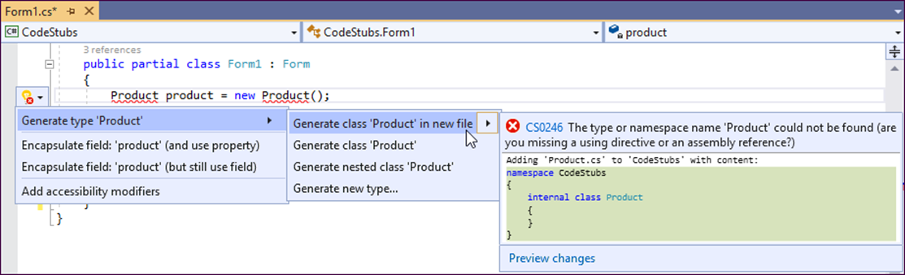
Using Generate From Usage to generate a class

Slide 60
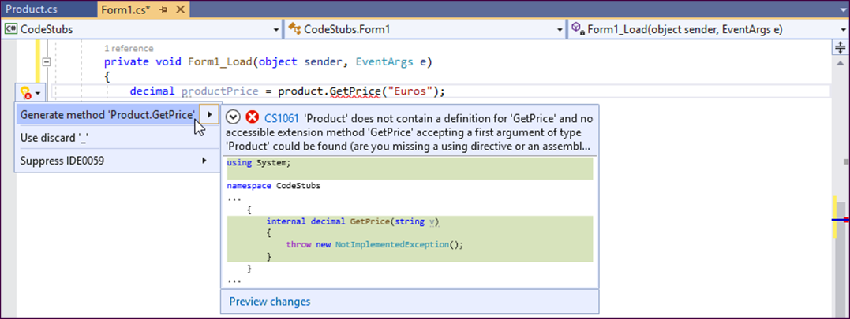
Using Generate From Usage to generate a method stub

Slide 61
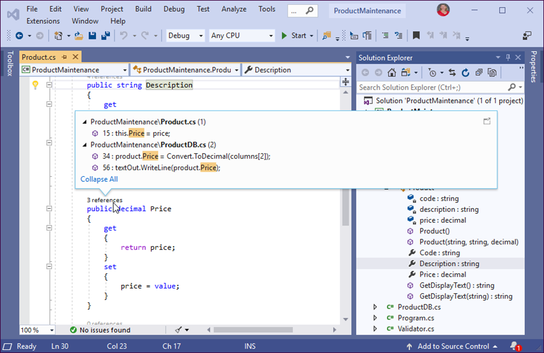
The Solution Explorer with the members of the Product class displayed

Slide 62
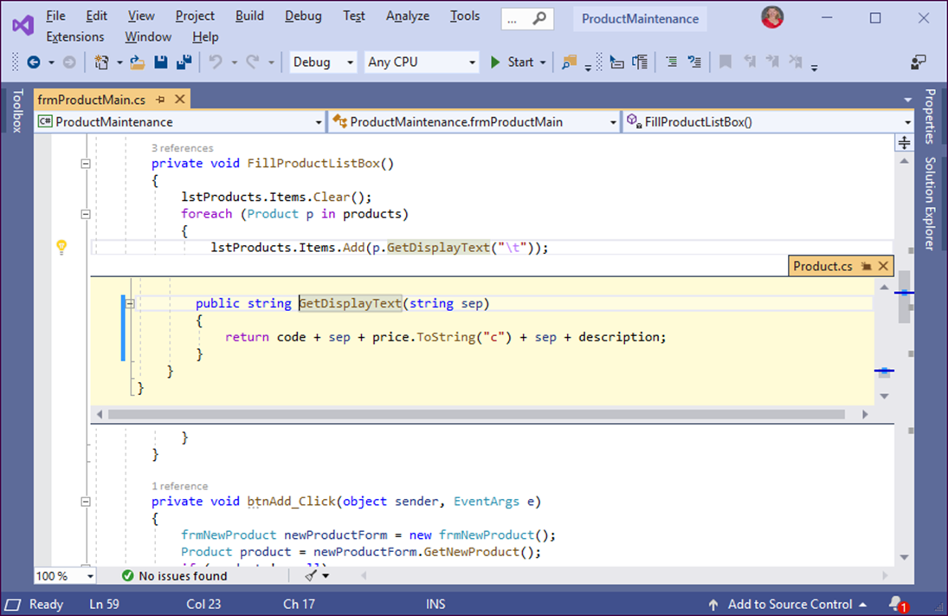
A Peek Definition window with the code for the GetDisplayText() method

Slide 63
The syntax for creating a structure
public [readonly] struct StructureName
{
structure members...
}

Slide 64
A Product structure
public struct Product
{
public Product(string code, string description,
decimal price)
{
this.Code = code;
this.Description = description;
this.Price = price;
}
public string Code { get; set; }
public string Description { get; set; }
public decimal Price { get; set; }
public string GetDisplayText(string sep) =>
Code + sep + Price.ToString("c") + sep + Description;
}

Slide 65
A read-only Product structure (C# 7.2 and later)
public readonly struct Product
{
public Product(string code, string description,
decimal price) {...}
public string Code { get; }
public string Description { get; }
public decimal Price { get; }
public string GetDisplayText(string sep) =>
Code + sep + Price.ToString("c") + sep + Description;
}

Slide 66
Code that declares a variable as a structure type and assigns values to it
// Create an instance of the Product structure
Product p;
// Assign values to each instance variable
p.Code = "C#";
p.Description = "Murach's C#";
p.Price = 59.50m;
// Call a method
string msg = p.GetDisplayText("\n");

Slide 67
Code that uses the default constructor to initialize the instance variables
Product p = new Product();
Code that uses the constructor that accepts parameters to initialize the instance variables
Product p = new Product("C#", "Murach's C#", 59.50m);

Slide 68
Code that creates and compares two structures
Product p1 = new Product("C#", "Murach's C#", 57.50m);
Product p2 = new Product("C#", "Murach's C#", 57.50m);
bool isEqual = p1.Equals(p2); // isEqual is true
p2.Price = 59.50m;
isEqual = p1.Equals(p2); // isEqual is false
Code that copies a structure and changes a value
Product product =
new Product("C#", "Murach's C#", 57.50m);
Product copy = product;
copy.Price = 59.50m;

Slide 69
The syntax for creating a record (C# 9.0 and later)
public record RecordName
{
record members...
}
A Product record
public record Product
{
public Product(string code, string description,
decimal price) {...}
public string Code { get; set; }
public string Description { get; set; }
public decimal Price { get; set; }
public string GetDisplayText(string sep) =>
Code + sep + Price.ToString("c") + sep +
Description;
}

Slide 70
Code that creates and compares two record instances
Product p1 = new Product("C#", "Murach's C#", 57.50m);
Product p2 = new Product("C#", "Murach's C#", 57.50m);
bool isEqual = p1.Equals(p2); // isEqual is true
p2.Price = 59.50m;
isEqual = p1.Equals(p2); // isEqual is false

Slide 71
The syntax for creating a record that only contains read-only properties
public record RecordName(propertyList);
A read-only Product record
public record Product(string Code, string Description, decimal Price);

Slide 72
Code that copies an instance of a read-only record and changes a value
Product product = new Product("C#", "Murach's C#", 57.50m);
By passing the values of the original to the constructor of the copy
Product copy1 =
new Product(product.Code, product.Description, 59.50m);
By using the with keyword
Product copy2 = product with { Price = 59.50m };

Slide 73
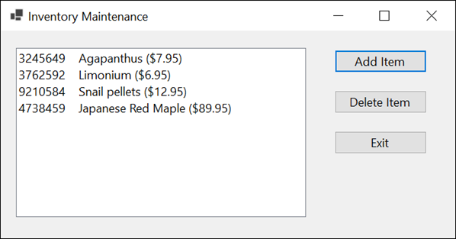
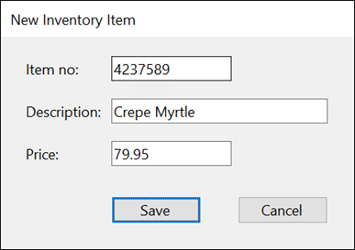
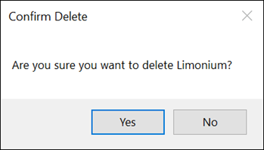
Extra 12-1 Create and use an Inventory Item class
Add a class for an inventory item to the Inventory Maintenance application and then add the code that uses this class.

Slide 74
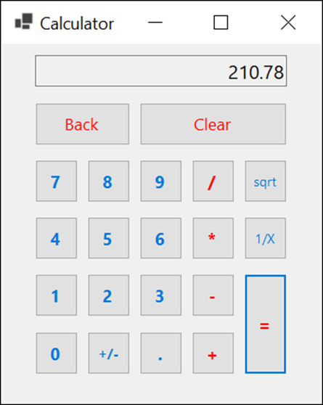
Project 3-1 Create a basic calculator
Create a form that lets the user perform the operations of a basic calculator, and create a class that performs those operations.

Slide 75
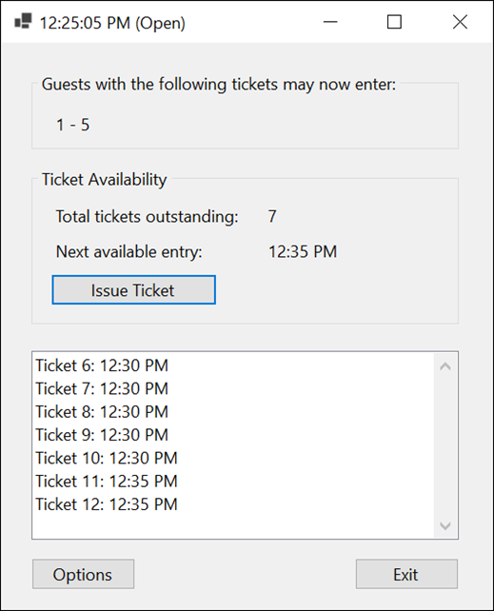
Project 3-2 Assign tickets with time slots (part 1)
Develop an application that assigns tickets that include a time slot when a guest can return to visit an attraction without waiting in line.

Slide 76
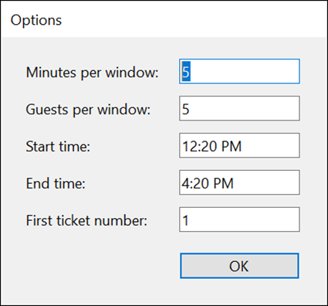
Project 3-2 Assign tickets with time slots (part 2)
Develop a form that lets the user specify the number of minutes for each time slot, the number of guests allowed during each time slot, the time the attraction opens and closes, and the number for the first ticket.

Slide 77
Objectives (part 1)
Applied
Given the specifications for an application that uses classes with any of the members presented in this chapter, develop the application and its classes.
Use the Solution Explorer to browse the classes in a solution.
Use the Peek Definition window to display and edit the code for a member in another class from within the class that refers to it.
Knowledge
List and describe the three layers of a three-layered application.
Describe these members of a class: constructor, method, field, and property.
Describe the concept of encapsulation.
Explain how instantiation works.

Slide 78
Objectives (part 2)
Describe the main advantage of using object initializers.
Describe the concept of overloading a method.
Explain what a static member is.
Explain how auto-implemented properties work.
Explain how expression-bodied properties, accessors, methods, and constructors work.
Describe pattern matching, including property patterns.
Describe the basic procedure for using the live code analysis feature to generate code stubs.
Describe the difference between a class, a structure, and a record.

